Slide 1

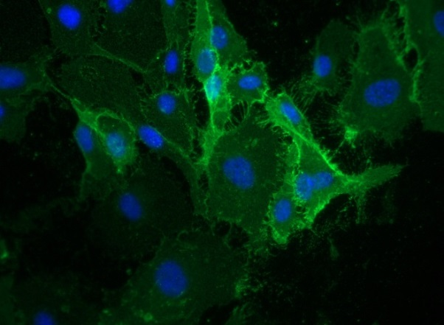
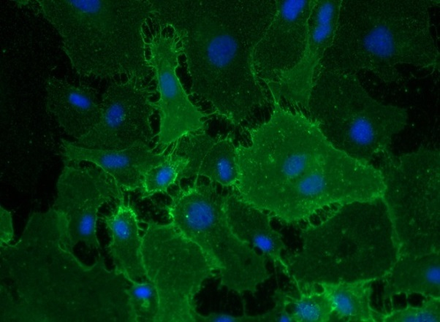
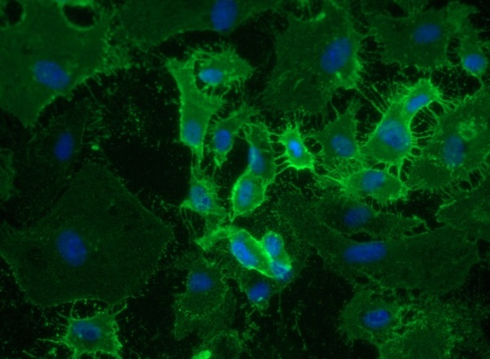
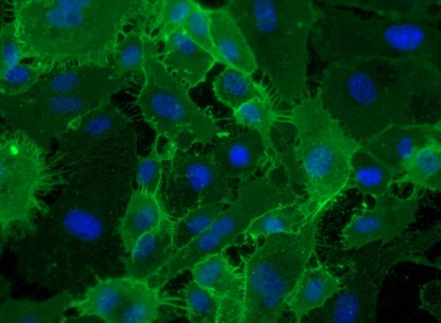
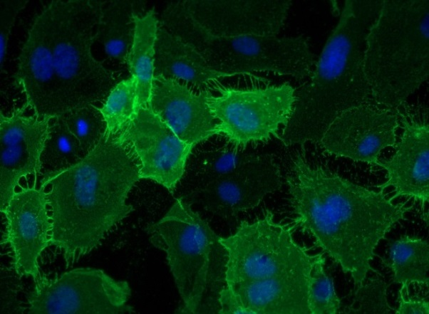
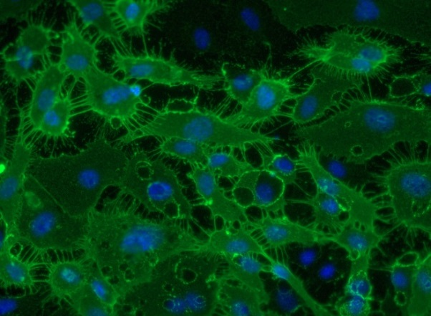
Reliatech GmbH
Mouse anti-human CD31 (#158-2B3)
(Cat #101-M92 / HU1401-01)
1:100
1:400
1:800
1:100 + 2% BSA
1:400 + 2% BSA
1:800 +2% BSA
Fig. 1: Immunofluorescence staining of human CD31 in HUVEC with and without BSA. Conjugated secondary antibody goat anti-mouse ALEXA Flour 488 [Dianova] was diluted 1:100 to 1:800. [IF_HU1401-01]
http://www.reliatech.de / orders@reliatech.de

